Slide 1
Chapter 14

Slide 2
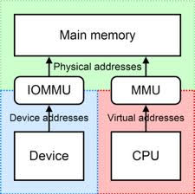
Topics
B-Trees
Memory Management

Slide 3
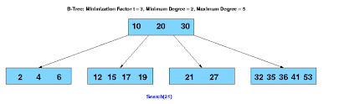
B-Trees

Slide 4
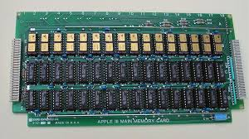
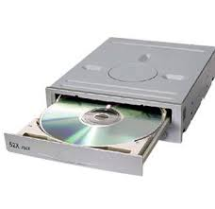
Storing a Large Map
What happens when implementing the map ADT (for example) for a large collection of elements that do not fit into main memory (internal)
Entries will be stored into external memory blocks called disk blocks
There is a tremendous performance difference between the two types of memory

Slide 5
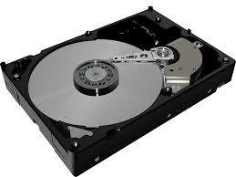
I/O Complexity Related Definitions
Disk transfer
Transfer of data between external and primary memory
I/O complexity
The number of disk transfers required to perform a search or update
Want to minimize the number of disk transfers to perform during queries or updates

Slide 6
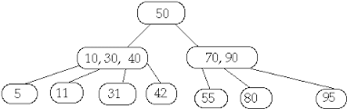
(a-b) Trees (1)
A generalized (2,4) tree is known as an (a-b) tree
Each node has between a and b children and stores between a - 1 to b - 1 keys (entries)
Provides a flexible search structure where the size of the nodes and running time depend on the parameters a and b

Slide 7
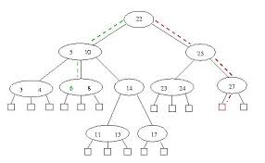
(a-b) Trees (2)
They can be used to reduce the impact of the performance difference between internal and external memory during queries or updates

Slide 8
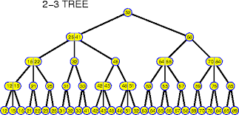
(a-b) Tree Definition
An (a-b) tree
a and b are integers such that 2 ≤ a ≤ (b+1)/2
Size property
Each internal nodes has at least a children (unless it is the root), and has at most b children
Depth property
All external nodes have the same depth
The height storing n entries is (log n/log b) and O(log n/log a)

Slide 9
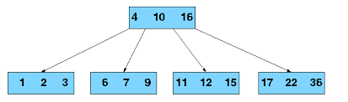
B-Trees (1)
A well known version of a (a-b) tree that maintains a map in external memory efficiently is called a B-tree of order d where
a =
b = d (maximum number of children per node)
An important property is that d can be chosen so that d children and corresponding d - 1 keys can fit into a single disk block
Implies that each node access requires only one disk transfer to perform a search or an update operation - O(1)

Slide 10
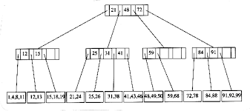
B-Trees (2)
If a node overflows because of an addition of a new entry (d+1 children) the node is split into two nodes having (d+1)/2 children
This process is repeated for at most log_{b}n levels
If a node underflows because of a removal, one performs a fusion operation

Slide 11
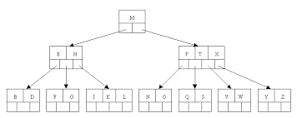
B-Trees (3)
A B-Tree with n-entries has I/O complexity O(log_{b}n) for search and update operations
Uses (n/B) blocks where B is the size of a block
A B-tree is kept balanced by requiring that all leaf nodes be at the same depth
The depth of a B-Tree will increase slowly as elements are added to the tree, but an increase in the overall depth is infrequent

Slide 12
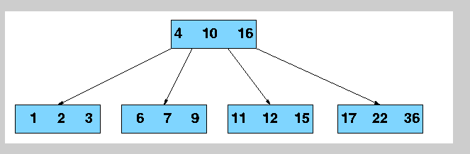
B-Trees Performance
Space | O(n) | O(n)
Search | O(log n) | O(log n)
Insert | O(log n) | O(log n)
Delete | O(log n) | O(log n)

Slide 13
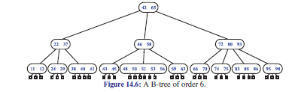
Sample B-Tree of Order 6
(3,6) tree

Slide 14
Advantages of B-tree Usage for Databases (1)
Keeps keys in sorted order for sequential traversing
Uses a hierarchical index to minimize the number of disk reads
Uses partially full blocks to speed insertions and deletions
Keeps the index balanced with a recursive algorithm

Slide 15
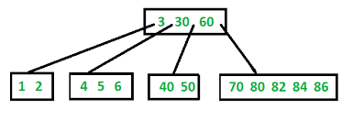
Advantages of B-tree Usage for Databases (2)
Minimizes waste by making sure the interior nodes are at least half full
Handles an arbitrary number of insertions and deletions

Slide 16
Advantages of B-tree Usage for Databases (3)
B-trees have substantial advantages over alternative implementations when the time to access the data of a node greatly exceeds the time spent processing that data, because then the cost of accessing the node may be amortized over multiple operations within the node

Slide 17
Advantages of B-tree Usage for Databases (4)
By maximizing the number of keys within each internal node, the height of the tree decreases and the number of expensive node accesses is reduced
While 2-3 B-trees are easier to understand, B-trees using secondary storage need a larger number of child nodes to improve performance

Slide 18
Disadvantage of B-tree Usage for Databases
Maximum key length cannot be changed without completely rebuilding the database

Slide 19
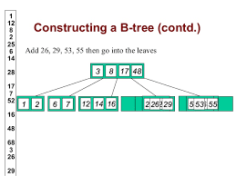
B-Trees Summary (1)
B-trees keep data sorted and allows searches, sequential access, insertions, and deletions in log time
Unlike self-balancing, the B-tree is optimized for systems that read and write large blocks of data
It is commonly used in databases and file systems

Slide 20
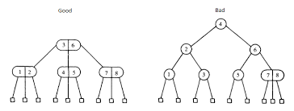
B-Trees Summary (2)
In B-trees, internal nodes can have a variable number of child nodes within some pre-defined range
When data is inserted or removed from a node, the number of child nodes changes
In order to maintain the pre-defined range, internal nodes may be fused or split

Slide 21

B-Trees Summary (2)
Because a range of child nodes is permitted, B-trees do not need re-balancing as frequently as other self-balancing search trees, but may waste some space
The lower and upper bounds on the number of child nodes are fixed for a particular implementation
For example, in a 2-3 B-Tree each internal node may have only 2 or 3 child nodes

Slide 22
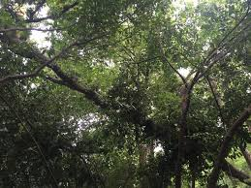
B-Trees Summary (3)
B-trees have substantial advantages over alternative implementations when the time to access the data of a node greatly exceeds the time spent processing that data, because then the cost of accessing the node may be amortized over multiple operations within the node

Slide 23
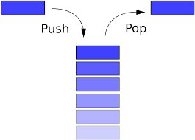
C++ Runtime Stack
Each executing program has an associated private stack
Composed of frames
Keeps track of function calls
Passed parameters and program counter
Supports recursion

Slide 24
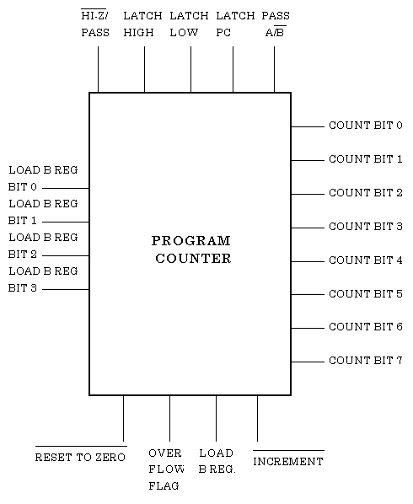
Program Counter
The run-time system maintains a special variable called a program counter (PC)
Keeps track of which machine instruction is currently being executed

Slide 25
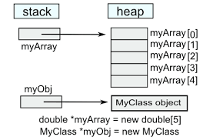
C++ Memory Allocation
The “new” and “delete” commands
Uses the memory heap (shared)
Divided into blocks
Common block size is 1024 bytes

Slide 26
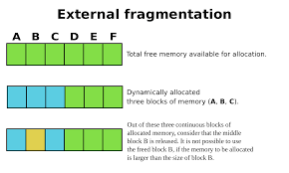
C++ Memory Allocation Algorithms
Popular method is to keep track of the contiguous “memory holes” available
Uses a doubly linked list
Called the free list

Slide 27
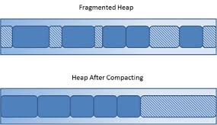
Fragmentation
Separation of unused memory
Want to minimize

Slide 28

Types of Fragmentation
Internal
Portion of memory that is not used
A thread allocated 1000 bytes but just used 100 bytes
Little can to done in this scenario
External
Unused memory between continuous blocks of memory

Slide 29
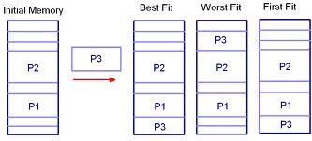
Memory Allocation Methods (1)
Best-fit algorithm
Searches the free list from the beginning to find a hole whose size is the closest to the amount of memory requested
Illustrates various techniques

Slide 30
Memory Allocation Methods (2)
First-fit algorithm
Searches the free list from the beginning for the first hole that is large enough to satisfy the memory requested

Slide 31
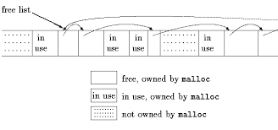
Memory Allocation Methods (3)
Next-fit algorithm
Searches the free list from where it left off previously to find the first hole that is large enough
Views the free list as a circular linked list

Slide 32
Memory Allocation Methods (4)
Worst-fit algorithm
Searches the free list to find the largest hole available
Might be done faster than a search of the entire free list if this list was maintained as a priority queue

Slide 33
Memory Allocation Methods (5)
During each algorithm
Requested memory is subtracted from the chosen memory hole
Left over part is returned to the free list

Slide 34
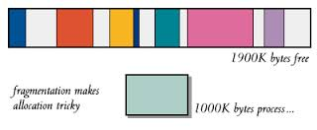
Fragmentation Comparison (1)
Best-fit
Tends to produce the worse results
First-fit
Tends to produce a lot of fragmentation at the front of the free list
Slows done later searches

Slide 35
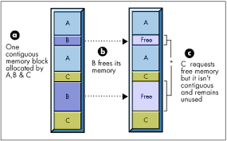
Fragmentation Comparison (2)
Next-fit
Spreads fragmentation more evenly
Keeps search time low
Difficult to allocate large blocks
Worst-fit
Attempts to avoid the problem of allocating large blocks
Keeps contiguous sections of memory as large as possible

Slide 36

Garbage Collection
In C++, the programmers can explicitly allocated and deallocate memory using the “new” and “delete” commands
In Java, the burden of memory management is entirely on the run-time environment

Slide 37

Garbage Collection
Run time environment notices when available space on the memory heap is scarce
Initiates garbage collection

Slide 38
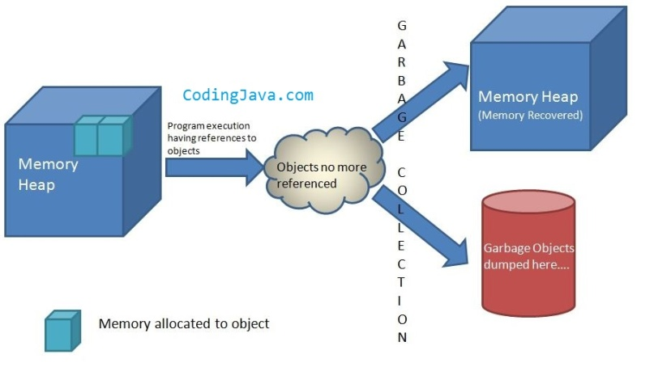
Mark-Sweep Algorithm (1)
Garbage collection routine
A “mark” bit is associated with objects that identifies if an object is live or not
When garbage collection is needed
All running threads are suspended
The “mark” bits are cleared

Slide 39

Mark-Sweep Algorithm (2)
A check is performed to see memory locations are live by using the directed graph version of the depth-first search traversal
Each object is viewed as a vertex
References from one object to another are considered to be edges

Slide 40
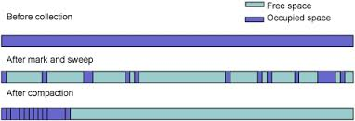
Mark-Sweep Algorithm (3)
Live objects are marked accordingly
Heap is scanned
Any space that is not being used is reclaimed

Slide 41

Memory Demand (Latency)
Modern processors place overwhelming demands on a memory system in terms of
Latency
Time interval between the stimulation and response
A time delay between the cause and the effect of some physical change in the system being observed
The delay in supplying an operand

Slide 42

Memory Demand (Bandwidth)
Bandwidth
The rate of data transfer, bit rate or throughput, measured in bits per second (bit/s)
The amount of data supplied per unit of time
Latency and bandwidth
Competing metrics
Increasing bandwidth usually increases latency

Slide 43
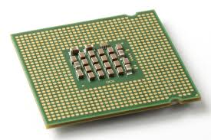
Memory Hierarchy
CPU
Internal registers
On the processor chip
Fast
Small
Cache
Internal (core) memory
External
Disks, CDs, DVDs

Slide 44
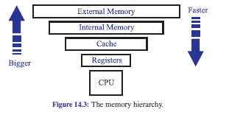
Memory Hierarchy

Slide 45
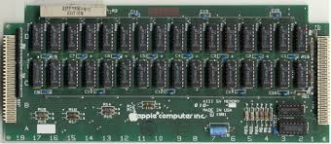
Cache Memory
Helps solve both latency and bandwidth metrics
Holds recently used memory in a small, fast memory, speeding up access
If a large percentage of the needed memory words are in cache, latency is reduced
An effective way to improve latency and bandwidth is to use multiple caches

Slide 46
Solution: Cache Memory
Includes some extra memory on the processor chip
Stores data that will be needed soon in the cache to facilitate easy access
Effective to use multiple levels of cache
CPU
cache
main memory

Slide 47
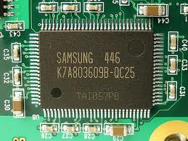
Types of Cache
Most modern computers have at least three independent caches
An instruction cache to speed up executable instruction fetch
A data cache to speed up data fetch and store
A translation lookaside buffer (TLB) used to speed up virtual-to-physical address translation for both executable instructions and data

Slide 48

Predicting Memory Usage
Temporal locality
If a program accesses a certain memory location, then is it likely to access this location again in the near future
Variable counter
Spatial locality
If a program accesses a certain memory location, then is it likely to access other locations nearby
An array

Slide 49
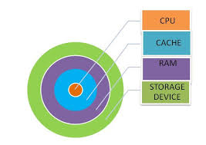
Cache Memory
When the processor needs to read from or write to a location in main memory, it first checks whether a copy of that data is in the cache
If so, the processor immediately reads from or writes to the cache, which is much faster than reading from or writing to main memory

Slide 50
Cache and Main Memory
Data is transferred between memory and cache in blocks of fixed size
Cache lines
When a cache line is copied from memory into the cache, a cache entry is created
The cache entry will include the copied data as well as the requested memory location (called a tag)

Slide 51
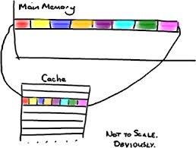
Cache Lines
Main memory is divided up into fixed-size blocks called cache lines
Typically consists of 4 to 64 consecutive bytes

Slide 52
Cache Hits and Misses (1)
The cache checks for the contents of the requested memory location in any cache lines that might contain that address
If the processor finds that the memory location is in the cache, a cache hit has occurred
If the processor does not find the memory location in the cache, a cache miss has occurred

Slide 53
Cache Hits and Misses (2)
When a cache hit occurs
The processor immediately reads or writes the data in the cache line
When a cache miss occurs
The cache allocates a new entry, and copies in data from main memory; then, the request is fulfilled from the contents of the cache

Slide 54
Cache Performance
The proportion of accesses that result in a cache hit is known as the hit rate
Is a measure of the effectiveness of the cache
Read misses
Delays execution because they require data to be transferred from memory
Much more slowly than the cache itself
Write misses
May occur without such penalty, since the processor can continue execution while data is copied to main memory in the background

Slide 55
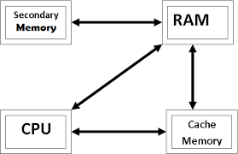
Page Replacement Algorithms
Dependent on the type of cache being used
In order to make room for the new entry on a cache miss, the cache may have to evict one of the existing entries
Replacement policy
The fundamental problem with any replacement policy is that it must predict which existing cache entry is least likely to be used in the future

Slide 56
Page Replacement Policies
First in, first out (FIFO)
Evict the page that has been in cache the longest
Page that was transferred to the cache furthest in the past
Least-recently used (LRU)
Evict the page whose last request occurred furthest in the past
Replaces the least recently accessed entry
Random
Choose a page at random to evict from cache
.
See next page

Slide 57
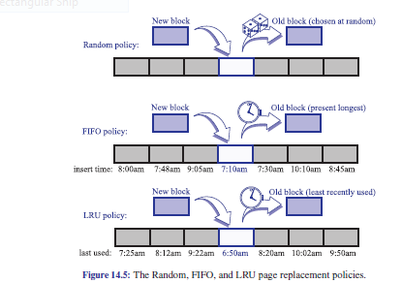
Page Replacement Policies

Slide 58
Page Replacement Performance
First in, first out (FIFO)
Easy to implement
Requires a queue to store references to pages in cache
Runs in O(1) time
Takes advantage of the temporal locality
Least-recently used (LRU)
Takes advantage of the temporal and spatial locality
Costly to implement
Random
Easiest to implement
Runs in O(1) time

Slide 59

Page Replacement Comparison
Based on experimental comparisons, the LRU has been shown to be superior to FIFO which is better than random

Slide 60
Write Policies
If data is written to the cache, at some point it must also be written to main memory

Slide 61
Additional Definitions

Slide 62
Write-Through
Updates cache and main memory simultaneously on every write
Keeps cache main memory consistent with main memory
All writes require main memory access
Slows down the system - If the there is another read request for main memory due to miss in cache, the read request has to wait until the earlier write was serviced

Slide 63
Write Back or Copy Back
Data that is modified is written back to main memory when the cache block is going to be removed from cache
Faster than write-through
Time is not spent accessing main memory
Writes to multiple words within a block require only one write to the main-memory
Need extra bit (dirty bit) in cache to indicate which block has been modified
Adds to size of the cache

Slide 64

Associatively (1)
The replacement policy decides where in the cache a copy of a particular entry of main memory will go
If each entry in main memory can go in just one place in the cache, the cache is direct mapped
Best (fastest) hit times
The best tradeoff for "large" caches

Slide 65

Associatively (2)
If the replacement policy is free to choose any entry in the cache to hold the copy, the cache is called fully associative
Many caches implement a compromise in which each entry in main memory can go to any one of k places in the cache (k-way set associative)

Slide 66
Direct Mapped Cache
For storing and retrieving data from cache, the memory address is divided into four components
TAG – Corresponds to the TAG in cache (65,536)
LINE – Indicates which cache entry holds the corresponding data (2048)
Word – Which word within the line is referenced
Bytes – (not normally used) – If a single byte is requested, it tells which byte within the word is needed. For a cache supplying 32 bits words, this field will be always 0
16
11
3
2
# of bits
TAG
LINE
Word
Bytes

Slide 67
Direct Mapped Cache
When the CPU generates an address
The LINE (11 bits) determines the cache entry
The two TAG fields are compared (address vs. cache)
If they agree, a cache hit occurs (no need to read memory)
If not, a cache miss occurs
The 32 byte cache is fetched from memory and stored in cache

Slide 68
Direct Mapped Cache
Let "x" be block number in cache, "y" be block number of memory, and "n" be number of blocks in cache, then mapping is done with the help of the equation x = y mod n
If we had 10 blocks of cache, block 7 of cache may hold blocks 7, 17, 27, or 37, … of main memory
If a program accesses data at location x and x + 65,536 (or a multiple of 65,536), the second instruction forces the cache entry to be reloaded since they have the same LINE value
Cache is swapped in and out of memory
This could result in poor performance

Slide 69
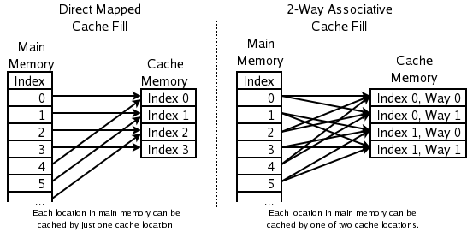
Direct Mapped Cache
This means that if two locations map to the same entry, they may continually knock each other out

Slide 70
Direct Mapped Example
Suppose memory consists of 2¹⁴ (16384) locations or words and cache has 2⁴ =16 cache lines and each cache line holds 8 (2³) words of data
Main memory is divided into 2¹⁴ / 2³ = 2¹¹ cache lines
Of the 14 bit addresses, we need 7 bits for TAG, 4 bits for the LINE, and 3 bits for the word
# of bits
7
4
3
TAG
LINE
Word

Slide 71

Direct Mapped Cache with 16 Entries

Slide 72
Direct Mapped Example
Suppose a program generates address 1AA
In 14 bit binary, this address is 000001 1010 1010
The first seven bits go in the TAG, the next 4 go in the LINE, and the final three go in the word
TAG
LINE
Word
0000011
0101
010

Slide 73

Direct Mapped Example
 |  |  | 7 | 6 | 5 | 4 | 3 | 2 | 1 | 0
Entry | Valid | Tag | Data
1
2
3
4
5 | 1 | 0000011 |  |  |  |  |  | 1AA
6
7
8
9
10
11
12
13
14
15
16

Slide 74
Direct Mapped Example
However if the program generates the address 3AB (000011 1010 1011)
Tag will be 0000111
LINE will be 0101 (same as 1AA)
Word will be 011
The block loaded for 1AA would be removed from cache and replaced by the blocks associated with the 3AB reference

Slide 75
Direct Mapped Example
 |  |  | 7 | 6 | 5 | 4 | 3 | 2 | 1 | 0
Entry | Valid | Tag | Data
1
2
3
4
5 | 1 | 0000111 |  |  |  |  | 3AB
6
7
8
9
10
11
12
13
14
15
16

Slide 76
Address
Address breakup is done this way due to spatial locality
Data from consecutive addresses are brought into cache
If the higher order bits were used, then values from consecutive address would map to the same location in cache
Using the middle bits cause less thrashing
7
4
3
TAG
LINE
Word

